Slide 1
Expectimax and Utilities
Many of today’s slides are courtesy of Dan Klein and Pieter Abbeel of University of California, Berkeley

Slide 2

Uncertain Outcomes
CIS 521 | 9
Notes:
.

Slide 3
max
chance
min
10
10
9
100
Idea: Uncertain outcomes controlled by chance, not an adversary!
CIS 521 | 10
Notes:
At least 10, or otherwise just rather dead; or just 100, or otherwise rather dead; that’s yet something different than minimax or expectimax
Down arrows = min nodes
Circles = chance nodes.

Slide 4
Expectimax Search
Why wouldn’t we know what the result of an action will be?
Explicit randomness: rolling dice
Unpredictable opponents: the opponent isn’t optimal
Actions can fail: when moving a robot, wheels might slip
Values should now reflect average-case (expectimax) outcomes, not worst-case (minimax) outcomes
Expectimax search: compute the average score under optimal play
Max nodes as in minimax search
Chance nodes are like min nodes but the outcome is uncertain
Calculate their expected utilities
I.e. take weighted average (expectation) of children
Later, we’ll learn how to formalize the underlying uncertain-result problems as Markov Decision Processes
max
chance
10
10
4
10
5
9
7
100
CIS 521 | 11
Notes:
.

Slide 5
Expectimax Pseudocode
def value(state):
if the state is a terminal state: return the state’s utility
if the next agent is MAX: return max-value(state)
if the next agent is EXP: return exp-value(state)
def max-value(state):
initialize v = -∞
for each successor of state:
v = max(v, value(successor))
return v
def exp-value(state):
initialize v = 0
for each successor of state:
p = probability(successor)
v += p * value(successor)
return v
CIS 521 | 12
Notes:
Max is just like before. Exp is the expectation of what will happen next.

Slide 6
Expectimax Pseudocode
def exp-value(state):
initialize v = 0
for each successor of state:
p = probability(successor)
v += p * value(successor)
return v
1/2
1/6
1/3
8
24
-12
$v=\frac{1}{2}⋅(8)+\frac{1}{3}⋅(24)$+ $\frac{1}{6}⋅(−12)$
CIS 521 | 13
Notes:
.

Slide 7
3
12
9
2
4
6
15
6
0
CIS 521 | 14
Notes:
Here imagine that all children are equally likely.
8 … 4 …. 7

Slide 8
3
12
9
2
CIS 521 | 15
Notes:
In Minimax we were done, since 2 would always be less than 3.
Here the average of 3, 12 and 9 = 8.
Can the average be less than 2 on the middle node? YES!!! Much harder to prune.

Slide 9
400
300
…
Estimate of true expectimax value (which would require a lot of work to compute)
492
362
…
CIS 521 | 16
Notes:
Let’s image they are actually random ghosts. 2 layers of random ghost actions.
At the actual end of the game, we have the score. But we can’t do that so we have to cut the process off.
So we need some way of evaluating the

Slide 10
Probabilities
CIS 521 | 17
Notes:
.

Slide 11
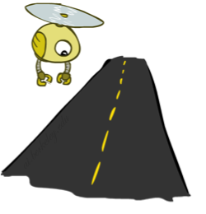
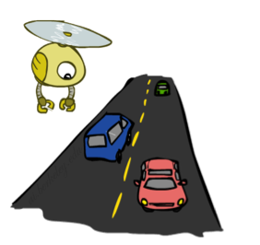
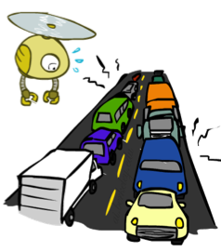
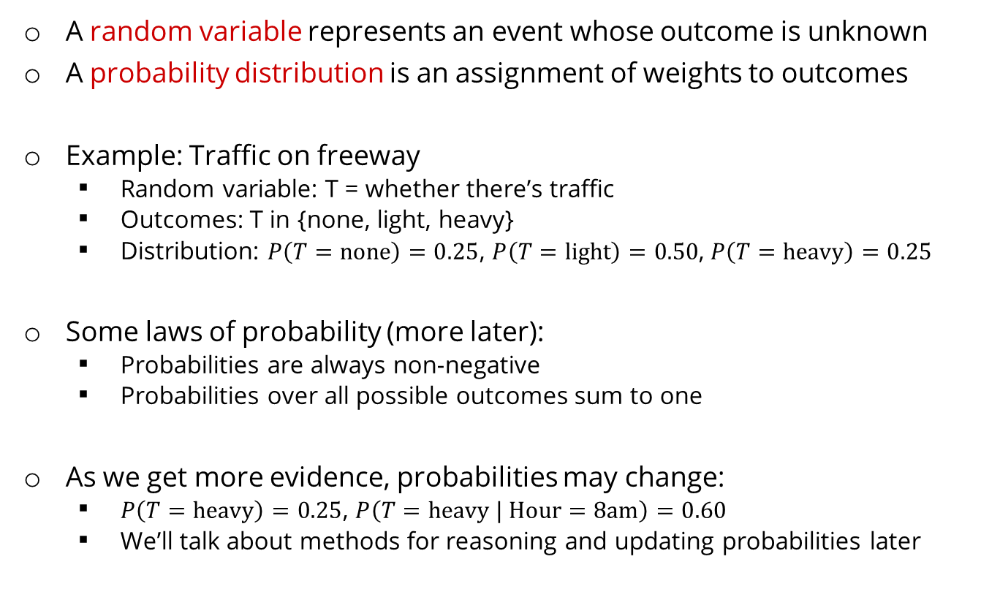
Probabilities
A random variable represents an event whose outcome is unknown
A probability distribution is an assignment of weights to outcomes
Example: Traffic on freeway
Random variable: T = whether there’s traffic
Outcomes: T in {none, light, heavy}
Distribution: $P\left(T=\text{none}\right)=0.25$, $P\left(T=\text{light}\right)=0.50$, $P\left(T=\text{heavy}\right)=0.25$
Some laws of probability (more later):
Probabilities are always non-negative
Probabilities over all possible outcomes sum to one
As we get more evidence, probabilities may change:
$P\left(T=\text{heavy}\right)=0.25$, $P\left(T=\text{heavy} | \text{Hour}=\text{8}\text{am}\right)=0.60$
We’ll talk about methods for reasoning and updating probabilities later
0.25
0.50
0.25
CIS 521 | 18
Notes:
In general, we will be computing probabilities. As we get more evidence the probabilities will change. We will look at Probabilistic Inference later in this course.

Slide 12
Probabilities
The expected value of a function of a random variable is the average, weighted by the probability distribution over outcomes
Example: How long to get to the airport?
20 min
30 min
60 min
Time:
35 min
x
+
x
+
x
Probability:
0.25
0.50
0.25
CIS 521 | 19
Notes:
.

Slide 13
What Probabilities to Use?
In expectimax search, we have a probabilistic model of how the opponent (or environment) will behave in any state
Model could be a simple uniform distribution (roll a die)
Model could be sophisticated and require a great deal of computation
We have a chance node for any outcome out of our control: opponent or environment
The model might say that adversarial actions are likely!
For now, assume each chance node magically comes along with probabilities that specify the distribution over its outcomes
Having a probabilistic belief about another agent’s action does not mean that the agent is flipping any coins!
CIS 521 | 20
Notes:
Where do the probabilities come from? For today, they come from the probability fairy. They are given by the problem definition. Later we will look at how to compute them.

Slide 14
Objectivist / frequentist answer:
Averages over repeated experiments
E.g. empirically estimating P(rain) from historical observation
Assertion about how future experiments will go (in the limit)
New evidence changes the reference class
Makes one think of inherently random events, like rolling dice
Subjectivist / Bayesian answer:
Degrees of belief about unobserved variables
E.g. an agent’s belief that it’s raining, given the temperature
E.g. agent’s belief how an opponent will behave, given the state
Often learn probabilities from past experiences (more later)
New evidence updates beliefs (more later)
CIS 521 | 21
Notes:
.

Slide 15
Quiz: Informed Probabilities
Let’s say you know that your opponent is actually running a depth 2 minimax, using the result 80% of the time, and moving randomly otherwise
Question: What tree search should you use?
Answer: Expectimax!
To figure out EACH chance node’s probabilities, you have to run a simulation of your opponent
This kind of thing gets very slow very quickly
Even worse if you have to simulate your opponent simulating you…
… except for minimax, which has the nice property that it all collapses into one game tree
0.1 0.9
CIS 521 | 22
Notes:
…Except, what if your opponent simulates you? You can get into this crazy recursive trees. If you go too far down the computation then
That only really works out for minimax.

Slide 16
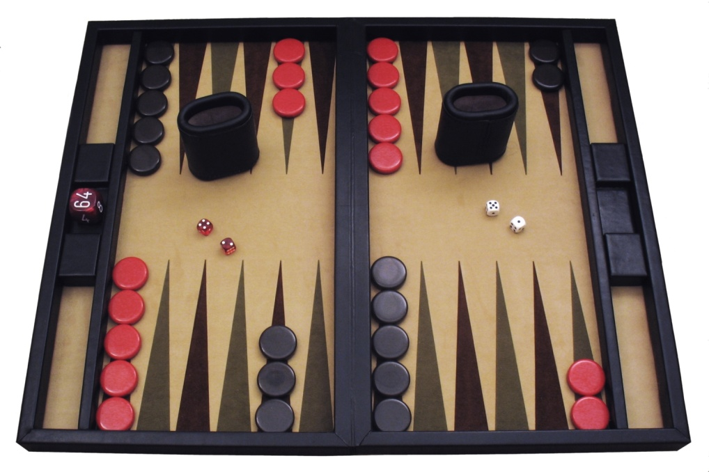
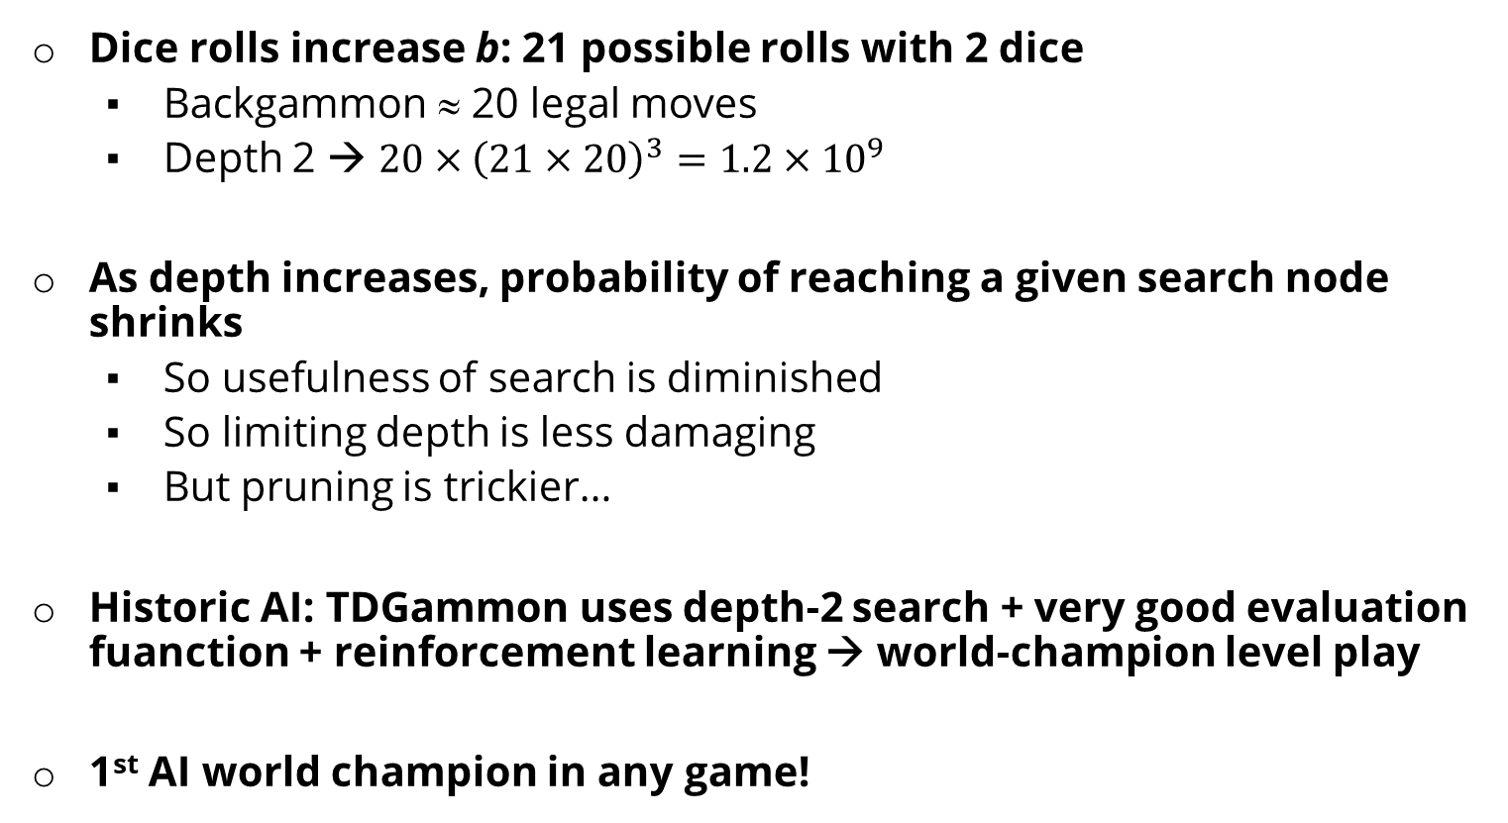
Dice rolls increase b: 21 possible rolls with 2 dice
Backgammon ≈ 20 legal moves
Depth 2 → $20×{\left(21×20\right)}^{3}=1.2×{10}^{9}$
As depth increases, probability of reaching a given search node shrinks
So usefulness of search is diminished
So limiting depth is less damaging
But pruning is trickier…
Historic AI: TDGammon uses depth-2 search + very good evaluation fuanction + reinforcement learning → world-champion level play
1st AI world champion in any game!
CIS 521 | 23
Notes:
TD-Gammon is a computer backgammon program developed in 1992 by Gerald Tesauro at IBM's Thomas J. Watson Research Center. Its name comes from the fact that it is an artificial neural net trained by a form of temporal-difference learning,

Slide 17
E.g. Backgammon
Expectiminimax
Environment is an extra “random agent” player that moves after each min/max agent
Each node computes the appropriate combination of its children
Max nodes
Chance nodes
Min nodes
CIS 521 | 24
Notes:
I move, you move. Each tie, we roll some dice. This is an expectimenimax tree.
If it’s terminal or we reached our depth limit, return utility.

